Slide 1
Permutation and combinattions
4.1

Slide 2
Fundamental Counting Principal
Find the number of choices for each option and multiply those numbers together.
Lets walk into TGIF and they are offering some mouth savoring deals.
Look at some menu options, we had 2 choices of appetizer, 3 choices of main dish, and 2 choices of dessert.

Slide 3
Factorial
n!=n(n-1)(n-2)…3*2*1

Slide 4
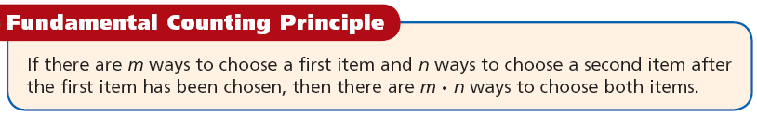
Sometimes there are too many possible outcomes to make a tree diagram or a list. The Fundamental Counting Principle is one method of finding the number of possible outcomes.
The Fundamental Counting Principle can also be used when there are more than two items to choose.

Slide 5
Example 1 Continued
A sandwich can be made with 3 different types of bread, 5 different meats, and 2 types of cheese. How many types of sandwiches can be made if each sandwich consists of one bread, one meat, and one cheese.
Method 2 Use the Fundamental Counting Principle.
3 • 5 • 2
There are 3 choices for the first item, 5 choices for the second item, and 2 choices for the third item.
30
There are 30 possible types of sandwiches.

Slide 6
Check It Out! Example 1
A voicemail system password is 1 letter followed by a 3-digit number less than 600. How many different voicemail passwords are possible?
Method 2 Use the Fundamental Counting Principle.
26 • 600
There are 26 choices for letters and 600 different numbers (000-599).
15,600
There are 15,600 possible combinations of letters
and numbers.

Slide 7
A compound event consists of two or more simple events, such as a rolled number cube landing with 3 showing and a tossed coin landing heads up. (A simple event has only one outcome, such as rolling a 3 on a number cube.) For some compound events, the order in which the simple events occur is important.
A combination is a grouping of outcomes in which the order does not matter.
A permutation is an arrangement of outcomes in which the order does matter.

Slide 8
Remember!
The sample space for an experiment is the set of all possible outcomes.

Slide 9
Example 2A: Finding Combinations and Permutations
Tell whether the situation involves combinations or permutations. Then give the number of possible outcomes.
An English test contains five different essay questions labeled A, B, C, D, and E. You are supposed to choose 2 to answer. How many different ways are there to do this.
List all possible groupings.
A&B
A&C
A&D
A&E
B&C
B&D
B&E
B&A
C&D
C&E
C&A
C&B
D&E
D&A
D&B
D&C

Slide 10
Example 2A Continued
The order of outcomes is not important, so this situation involves combinations. Eliminate the groupings that are duplicates.
A&B
A&C
A&D
A&E
B&C
B&D
B&E
B&A
C&D
C&E
C&A
C&B
D&E
D&A
D&B
D&C
There are 10 different ways to choose 2 questions.

Slide 11
Example 2B: Finding Combinations and Permutations
Tell whether the situations involves combinations or permutations. Then give the number of possible outcomes.
A family of 3 plans to sit in the same row at a movie theater. How many ways can the family be seated in 3 seats?
A, B, C
B, A, C
C, A, B
List all possible groupings.
A, C, B
B, C, A
C, B, A
The order of outcome is important. This situation involves permutations.
There are six different ways the family can sit.

Slide 12
Check It Out! Example 2a
Tell whether the situation involves combinations or permutations. Then give the number of possible outcomes.
Ingrid is stringing 3 different types of beads on a bracelet. How many ways can she use one bead of each type to string the next three beads?
R, G, B
G, R, B
B, R, G
List all possible designs.
R, B, G
G, B, R
B, G, R
The order of outcomes is important. This situation involves permutations.
There are six different ways the beads can be strung.

Slide 13
Check It Out! Example 2b
Nathan wants to order a sandwich with two of the following ingredients: mushroom, eggplant, tomato, and avocado. How many different sandwiches can Nathan choose?
List all possible groupings.
mushroom & eggplant
eggplant & tomato
mushroom & tomato
eggplant & avocado
mushroom & avocado
tomato & avocado
The order of outcomes is not important. This situation involves combinations.
There are six different ways to make the sandwich.

Slide 14
The factorial of a number is the product of the number and all the natural numbers less than the number. The factorial of 5 is written 5! and is read “five factorial.” 5! = 5 • 4 • 3 • 2 • 1 = 120. Factorials can be used to find the number of combinations and permutations that can be made from a set of choices.

Slide 15
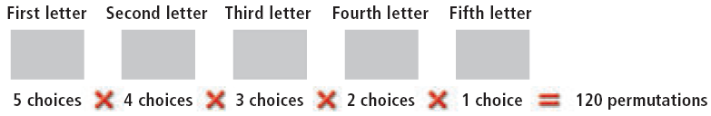
Suppose you want to make a five-letter password from the letters A, B, C, D, and E without repeating a letter. You have 5 choices for the first letter, but only 4 choices for the second letter. You have one fewer choice for each subsequent letter of the password.

Slide 16
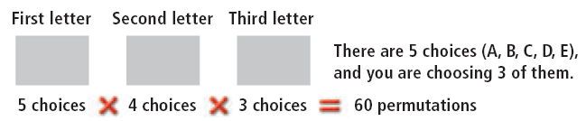

Suppose you want to make a three-letter password from the 5 letters A, B, C, D, and E without repeating a letter. Again, you have one fewer choice for each letter of the password.
The number of permutations is:

Slide 17
Helpful Hint
The factorial of 0 is defined to be 1.
0! = 1

Slide 18
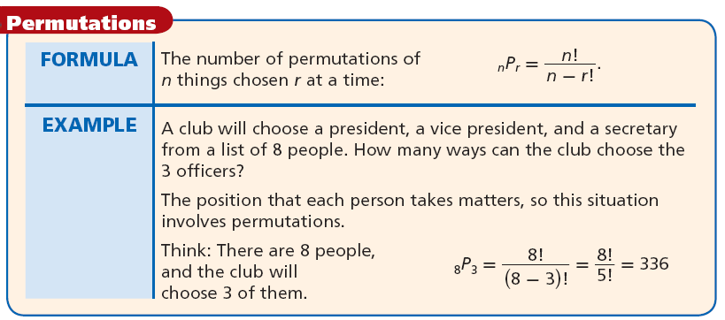

Slide 19


Example 3: Finding Permutations
A group of 8 swimmers are swimming in a race. Prizes are given for first, second, and third place. How many different outcomes can there be?
The order in which the swimmers finish matters so use the formula for permutations.
n = 8 and r = 3.
A number divided by itself is 1, so you can divide out common factors in the numerator and denominator.
There can be 336 different outcomes for the race.

Slide 20


Check It Out! Example 3
How many different ways can 9 people line up for a picture?
The order in which the people line up matters so use the formula for permutations.
n = 9 and r = 9.
A number divided by itself is 1, so you can divide out common factors in the numerator and denominator.
= 362,880
There are 362,880 ways the 9 people can line up for the picture.

Slide 21
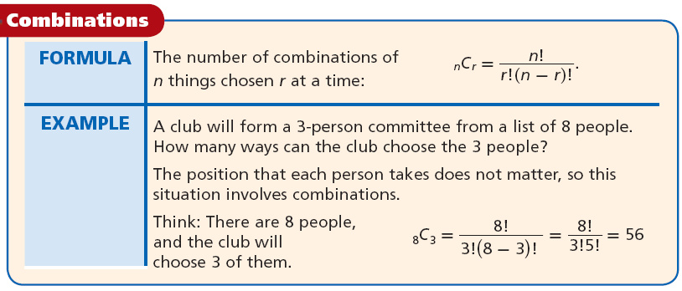
The formula for combinations also involves factorials.

Slide 22



Example 4: Finding Combinations
Four people need to be selected from a class
of 15 to help clean up the campus. How many different ways can the 4 people be chosen?
The order in which the students are selected does not matter, so use the formula for combinations.
Method 1 Use the formula for combinations.
n =15 and r =4

Slide 23



Check It Out! Example 4
A basketball team has 12 members who can play any position. How many different ways can the coach choose 5 starting players?
The order in which the players are selected does not matter, so use the formula for combinations.
Method 1 Use the formula for combinations.
n =12 and r =5

Slide 24
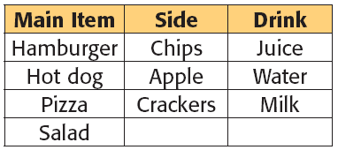
Lesson Quiz: Part I
1. A lunch special includes one main item, one side, and one drink.
How many different meals can you choose if you pick one main item, one side, and one drink?
36

Slide 25
For Problems 2-3, tell whether each situation involves combinations or permutations. Then give the possible number of outcomes.
2. When ordering a pizza, you can choose 2 toppings from the following: mushrooms, olives, pepperoni, pineapple, and sausage. How many different types of pizza can you order?
combinations; 10
3. Three people in a writing contest are competing for first, second and third prize. How many ways can the 3 people be chosen?
permutations; 6

Slide 26
4. You are ordering a triple-scoop ice-cream cone. There are 18 flavors to choose from and you don’t care which flavor is on the top, middle, or bottom. How many different ways can you select a triple-scoop ice-cream cone?
816
5. An art gallery has 12 paintings in storage. They have room to display 4 of them, with each painting in a different room. How many possible ways can they display the 4 additional paintings.
11,880

